Slide 1
Sukabumi Traffic Level Prediction
Sharon Regina
Kelompok 7
DSLS 2023

Slide 2
Business Understanding
Situation:
Sukabumi Satpol PP wants to allocate the traffic to alternative routes when the traffic level is high / bad.
Complication:
Satpol PP felt it is hard to assess the traffic level based on eye observation.
Resolution:
Create a model which can predict traffic level based on other factors.

Slide 3
Data Understanding
Alert Data: 667 rows
Contains user’s alert data indicating Jam/ weather/ accident of certain street in certain time.
Jam Data: 10,387 rows
Contains traffic level, length, delay, speed of a certain street in certain time.
Irregularities Data: 82 rows
Contains traffic level, length, delay, speed of a certain street in certain time.

Slide 4
Data Cleansing and Preprocessing
To join the three datasets, the street and time columns are chosen to be the keys since they are in all 3 datasets.
Jam & Irregularities Dataset: There are 82 overlapping columns between jam and irregularities dataset. The numbers for median length and median delay differ but since the jam level is the same and jam dataset has much more data, it is decided to use jam dataset and discard the irregularities dataset.
Jam & Alert Dataset: Turns out that in one street and one time, there can be > 2 alert types. This means that there is no unique id to join to the jam dataset. Hence, we cannot use this dataset.
In summary, only Jam Dataset is used.

Slide 5
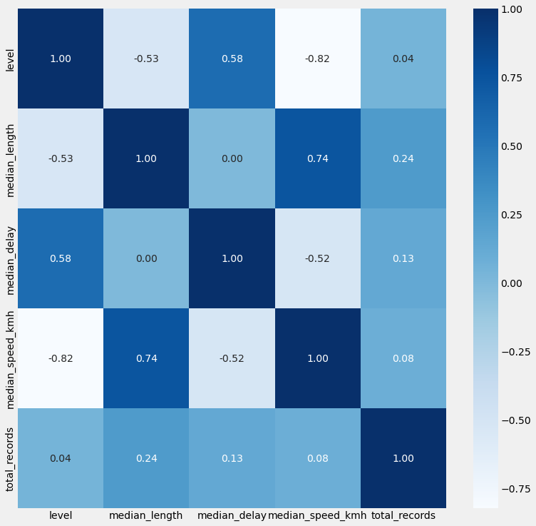
Correlation Analysis
Correlation between total_records and level is <0.05 -> not significant, can be dropped
Correlation between median_delay and level is moderately positive 0.58.
Correlation between median_length and median_speed_kmh is 0.74, indicating multi-colinearity, one of them should be dropped.
Correlation between level and median speed km/h is -0.84, stronger than median length with -0.53 so median length should be dropped instead.
In summary, Level, Median_Delay and Median_speed_kmh are the features used.

Slide 6
Modeling
After numerical feature scaling (test size 30%) and handling imbalance target variable using SMOTE, classifier and regression models are used and evaluated.
Since in this traffic case, false negative is more costly than false positive, we use recall score to measure the score of the model.

Slide 7
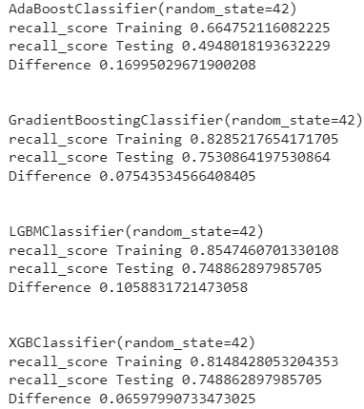
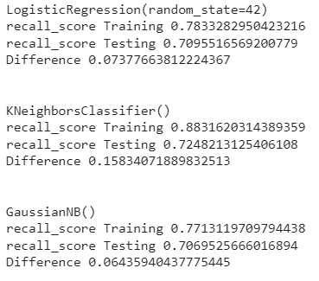
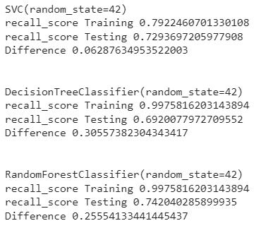
Model Results
The baseline for a model to not be considered as overfitting is when train - test has absolute value of <= 0.1, hence the models which do not over fit are: logistic regression, gaussian, SVC, Gradientboosting and XGBclassifier. The best recall score is GradientBoostingClassifier.

Slide 8
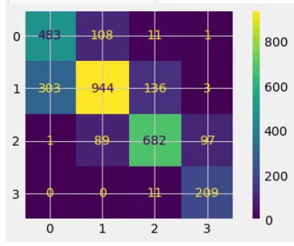
Results: Confusion Matrix
True Positive: 2318
Total Population: 3048
TPR: 76%
The Gradient Boost model can predict the traffic level accurately 76% of the time, using features: Median_Delay and Median_speed_kmh.
Sukabumi Satpol PP can now predict the traffic level on roads and relocate the traffic flow to roads with lower traffic level.

